Slide 1
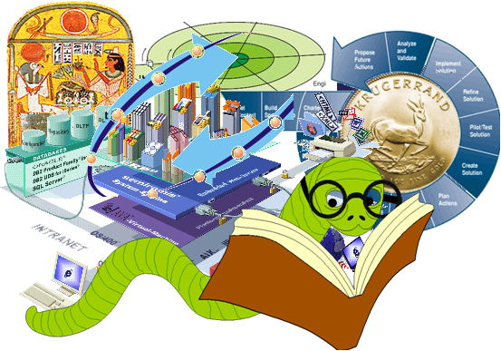
Software Engineering Process
& Models

Slide 2
Agenda
Need of Software Development Process
Phases & Activities in SDP
Characteristics of a mature SDP
Concept and Characteristics of SDP Models
Traditional SDP Models
Ad-hoc, Waterfall, V-Shape, Prototyping, Incremental Enhancement, Spiral, RAD
Capability Maturity Model

Slide 3
Software Development Process
Also call Software Development Life Cycle (SDLC)
SDP is process of developing software
Starts with a need, gets mature to a plan and ends with producing a software meeting the need
Need 🡪 Proposal 🡪 Plan 🡪 Solution

Slide 4
Characteristics of Mature SDP
Formal Set of Guidelines
Effective management control over technical efforts
Estimate Efforts and Schedule
Has a defined plan of action
Measureable for progress and performance
Verifiable

Slide 5
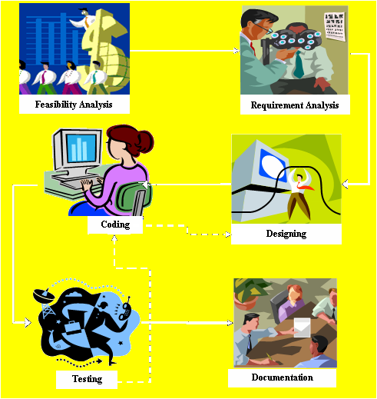
Phases and Activities in SDP

Slide 6
Concept of SDLC Model
Abstraction of SDP
Specialization of Generalization in SDP
Specification in embodiment of SDP
Different for different conditions and circumstances

Slide 7
Ad-hoc SDLC Model
Advantages
Simple & Quick
Direct working
Result oriented
Build
Fix
Disadvantages
No planning, Do not suit to big projects
No Documentation, No tracing
Highly risky relying on expertise of team

Slide 8
Waterfall SDLC Model
+ve
Linear & Simple
Highly documented and traceable
Formal closure of each step
-ve
No looking back
No iterations
Long waiting to product feel
Low Customer interaction
Requirement analysis
Software Design & Detailed Design
Unit Implementation & Unit Testing
Integration & System Testing
Installation & Operation
Maintenance & Enhancement

Slide 9
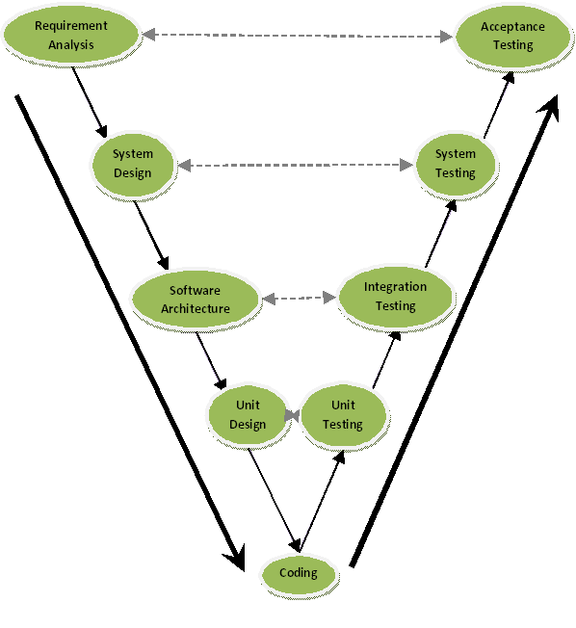
V-Shape SDLC Model
+ve
Early Testing Made possible
Linear & Simple
Highly documented and traceable
-ve
No looking back
No iterations
Long waiting to product feel
Low Customer intration

Slide 10
Evolutionary SDLC Model
+ve
Iterative
Better Customer involvement
Requirement Evolving
-ve
Time and effort consuming
May be misled to wrong directions of focus
May result in bad design
Modify/Update the requirement specifications
Quickly design and implement the partial requirement specifications
Collect customer/user feedback on the development

Slide 11
Throwaway Prototype Model
Initial Specifications
+ve
Iterative
Better Customer involvement
Requirement Evolving
Good Design
-ve
Wasting Time and effort
May be misled to wrong directions of focus
Quickly design and implement partial requirement specifications
Modify/Update requirement specifications
Customer/User Review
Final Specifications
Design & Implement
Test & Delivery
Operation and Maintenance

Slide 12
Exploratory SDLC Model
Initial Specifications
+ve
Iterative
Better Customer involvement
Requirement Evolving
Quick Delivery
-ve
May be misled to wrong directions of focus
Not good in design
Results are less maintainable
Quickly design and implement partial requirement specifications
Modify/Update requirement specifications
Customer/User Review
Final Selected Prototype
Quality improvement
Test & Delivery
Operation and Maintenance

Slide 13
Iterative Enhancement Model
+ve
Iterative
Good Design
Huge projects accommodated
Phase wise output
-ve
Needs strong management
Needs strong Configuration management
Marketing is a challenge
Iteration 1 Iteration 2 Iteration 3 Iteration N
Elicitation
Elicitation
Elicitation
Elicitation
Elaboration
Elaboration
Elaboration
Elaboration
Construction
Construction
Construction
Construction
Transition
Transition
Transition
Transition
Version A
Version B
Version C
Version X

Slide 14
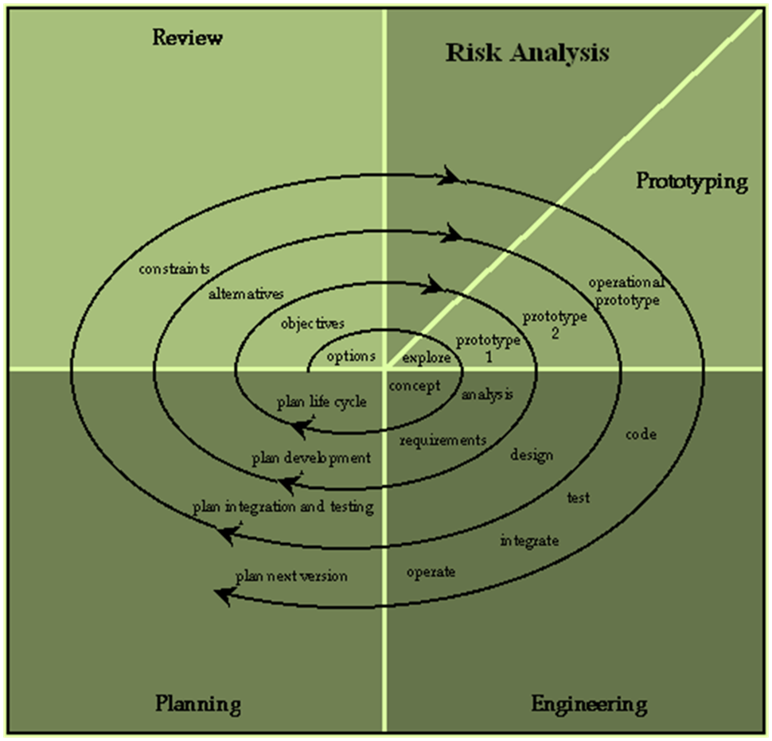
Spiral SDLC Model
+ve
Iterative
Good Design
Huge projects accommodated
Phase wise output
Adds benefits of all models
-ve
Needs strong management
Needs strong Configuration management
Delivery
Development
Analysis
Maintenance
Project initiation

Slide 15
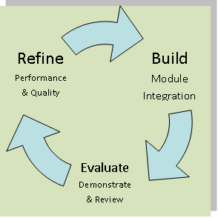
RAD SDLC Model
Analyze & Design
+ve
Iterative
Huge projects accommodated
Quick Delivery in minimum time
Best use of reusable off-the-shelf components
-ve
Result relies on availability of required reusable components
Quality of result depends on quality of components
Cycles of selecting reusable modules and Integration
Testing
Deployment
Maintenance
Operation and Learning

Slide 16
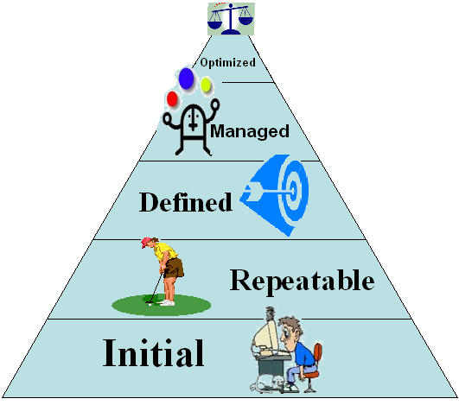
Capability Maturity Model
CMM is NOT SDLC Model
Measures maturity of SDP of organization
used as a guideline for software process improvement efforts

